Slide 1

Nanite
Unreal Engine’s new virtualized geometry technology
makes static meshes smaller in file size, but faster to render
allows use of much more detailed meshes
uses algorithms to render only the detail that can be seen, and nothing more
occlusion culling - the technique of not rendering triangles that will get blocked by other triangles

Slide 2
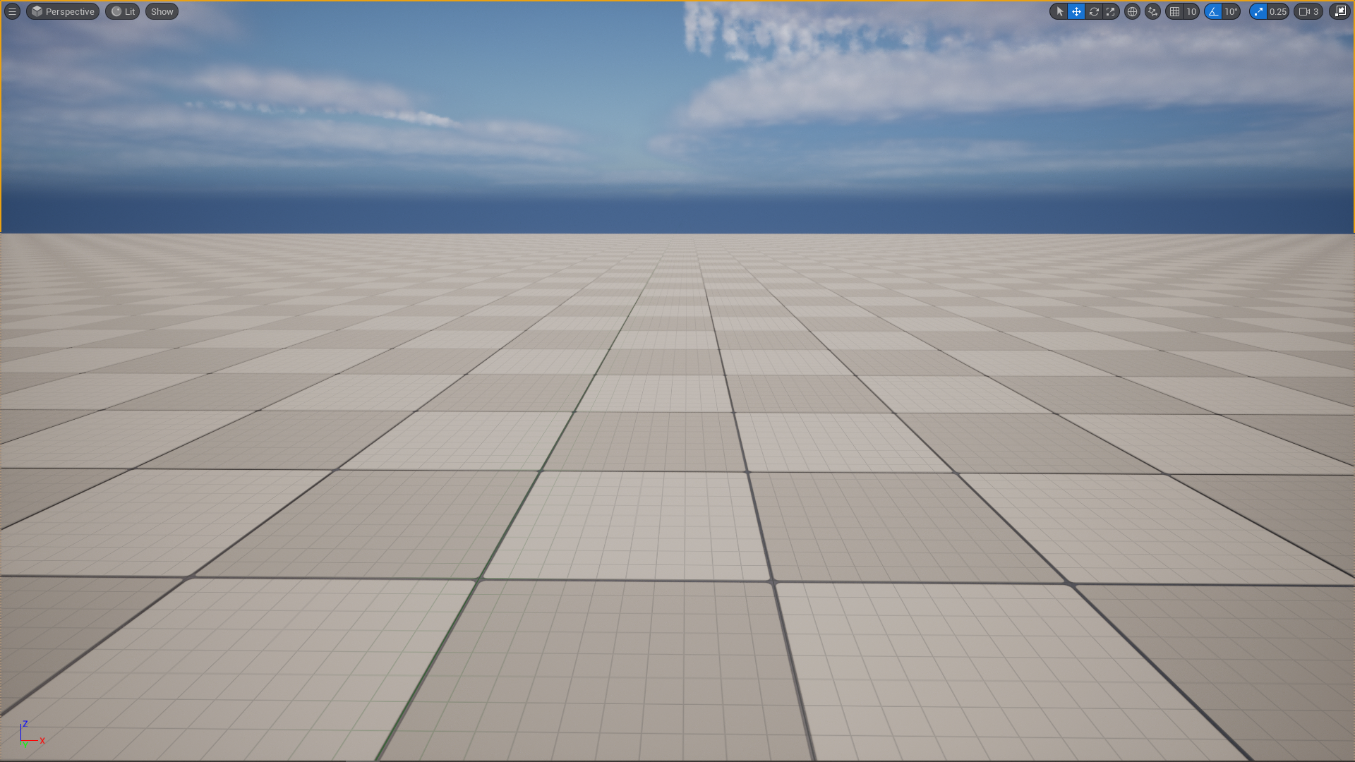
Nanite

Slide 3
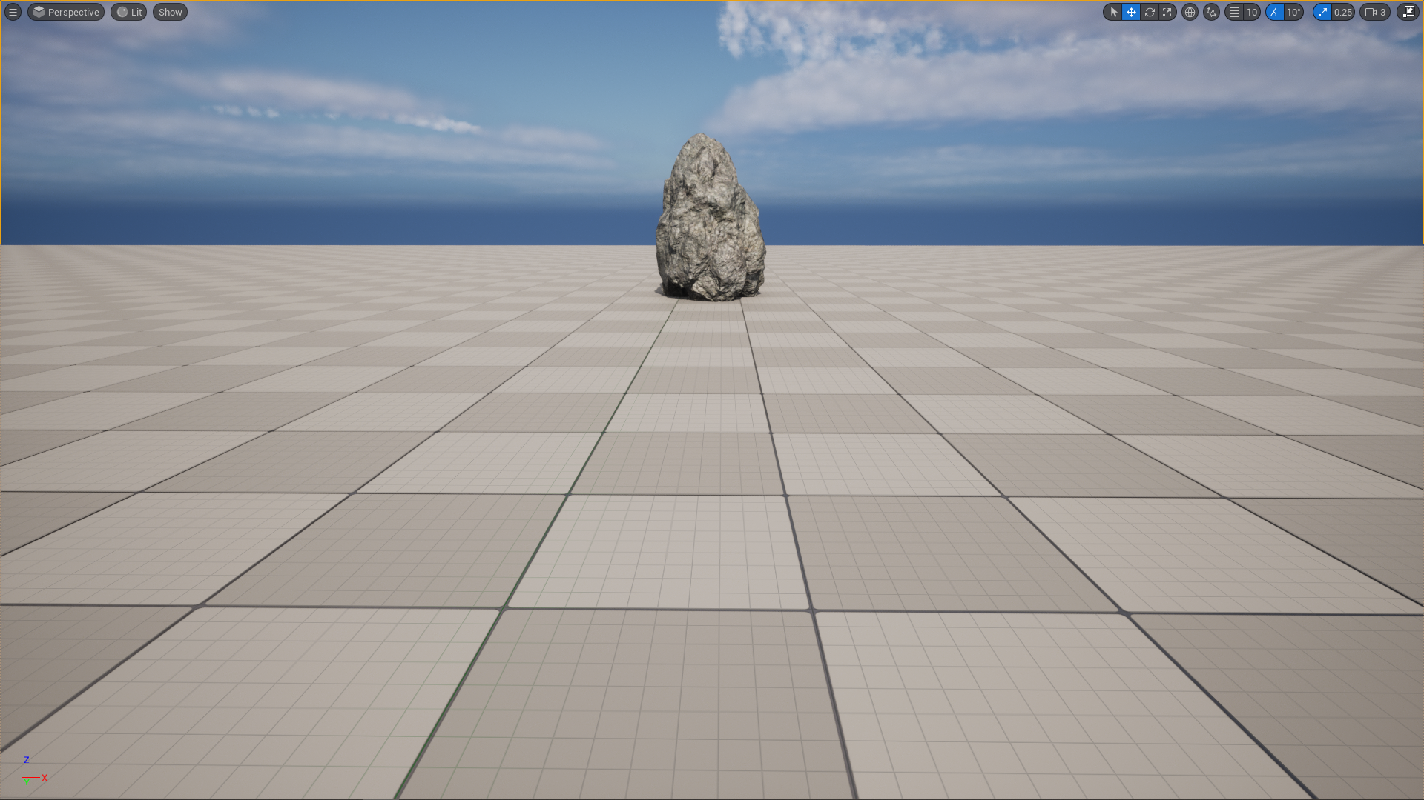
Nanite

Slide 4
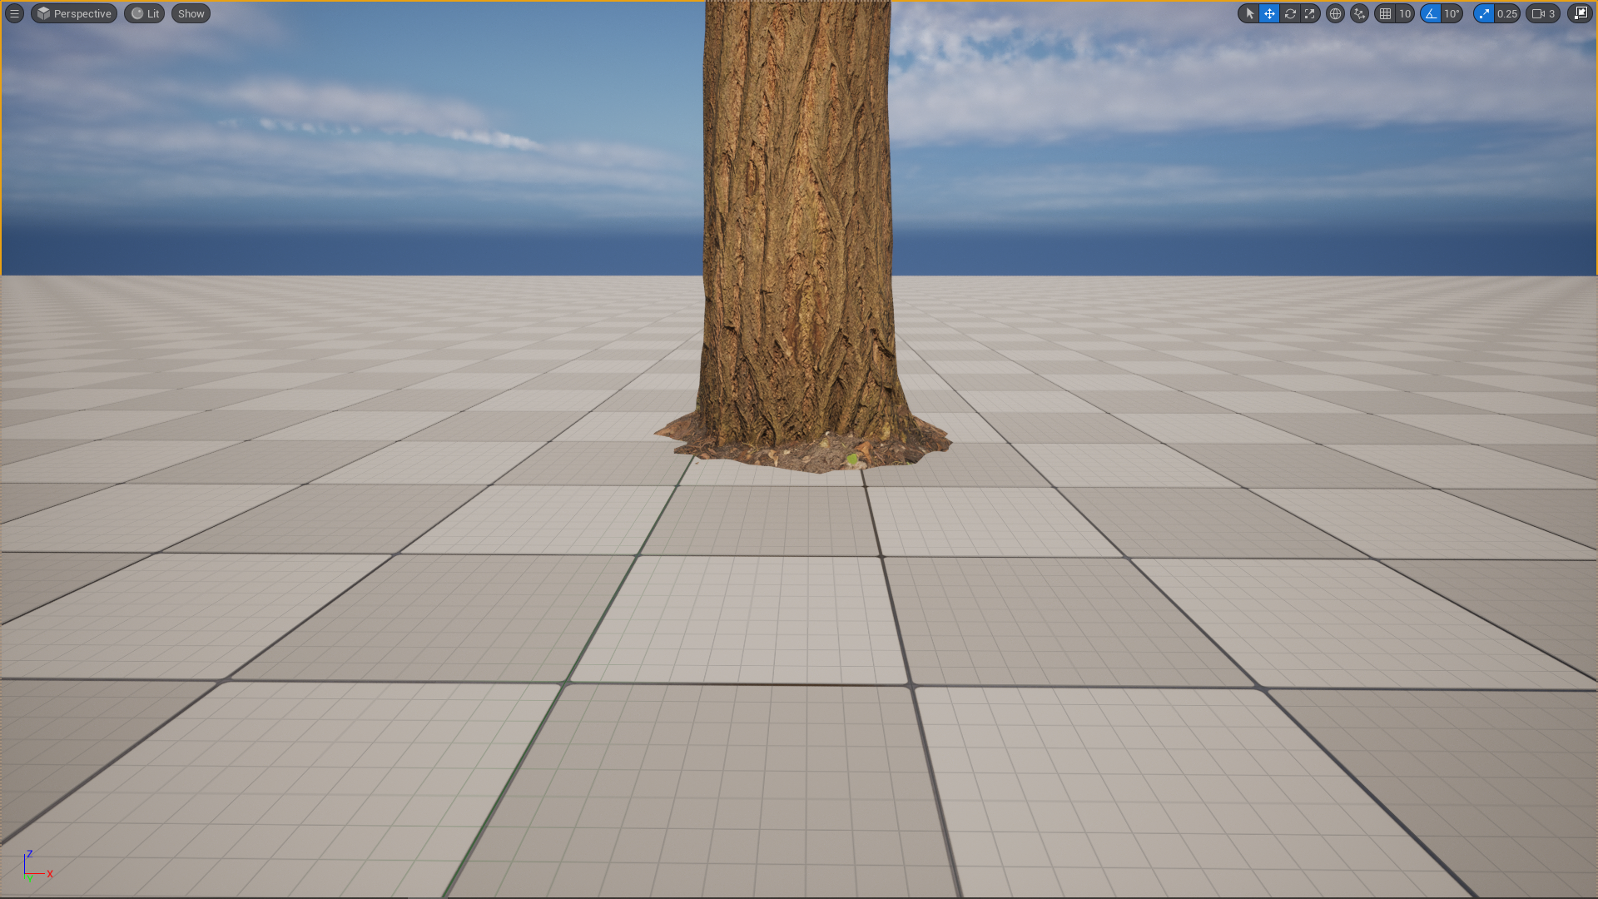
Nanite

Slide 5
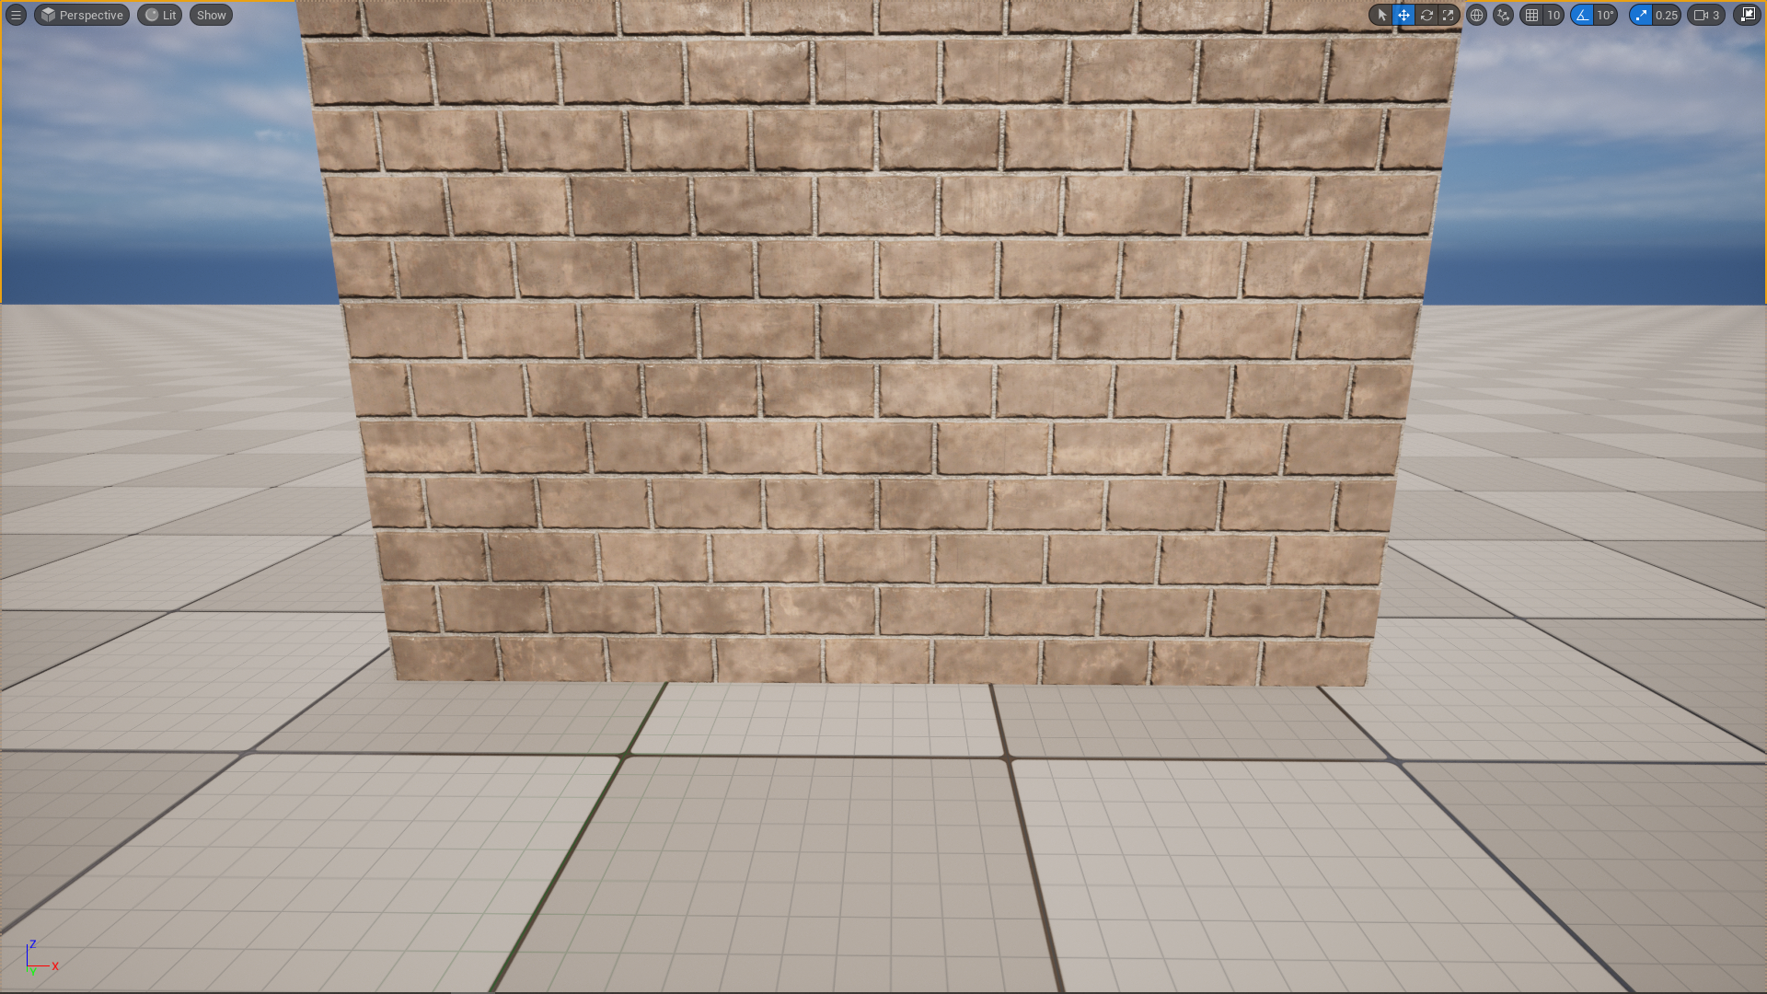
Nanite

Slide 6
Nanite
Unreal Engine’s new virtualized geometry technology
makes static meshes smaller in file size, but faster to render
allows use of much more detailed meshes
uses algorithms to render only the detail that can be seen, and nothing more
occlusion culling - the technique of not rendering triangles that will get blocked by other triangles
uses an extremely efficient Level of Detail system

Slide 7
Nanite
Unsupported Features (Mesh Deformation)
Skeletal Meshes
Spline Meshes
Morph Targets
Vertex Painting (vertex colors imported in are ok)

Slide 8
Nanite
Unsupported Features (Materials)
Blend Modes other than Opaque and Masked
Wireframe
Vertex Interpolator node and Custom UVs are supported but will evaluate 3 times per pixel (less efficient)

Slide 9
Nanite
Unsupported Features (Rendering)
Forward Rendering
Stereo Rendering (VR)
Split Screen
Multisampling Anti-Aliasing (MSAA)
Lighting Channels

Slide 10
Nanite
Supported Platforms (Consoles)
PlayStation 5
Xbox Series S and X
PlayStation 4, Xbox One (experimental)

Slide 11
Nanite
Supported Platforms (PCs)
NVIDIA Maxwell-generation or newer (GeForce GTX 745)
AMD GCN-generation or newer (Radeon HD 7730)
DirectX 12, Shader Model 6, updated graphics drivers
>= Windows 10 version 1909.1350
SSD (recommended)

Slide 12
Nanite
File Size Comparison
High Polygon Static Mesh
Nanite Mesh
Triangles: 1,545,338
Vertices: 793,330
Num LODs: 4
Nanite: Disabled
Compressed Size: 148.95 MB
Triangles: 1,545,338
Vertices: 793,330
Num LODs: n/a
Nanite: Enabled
Compressed Size: 19.64 MB

Slide 13
Nanite
File Size Comparison
Low Polygon Static Mesh
Nanite Mesh
Triangles: 19,066
Vertices: 10,930
Num LODs: 4
Nanite: Disabled
Compressed Size: 1.34 MB
Triangles: 1,545,338
Vertices: 793,330
Num LODs: n/a
Nanite: Enabled
Compressed Size: 19.64 MB

